Slide 1
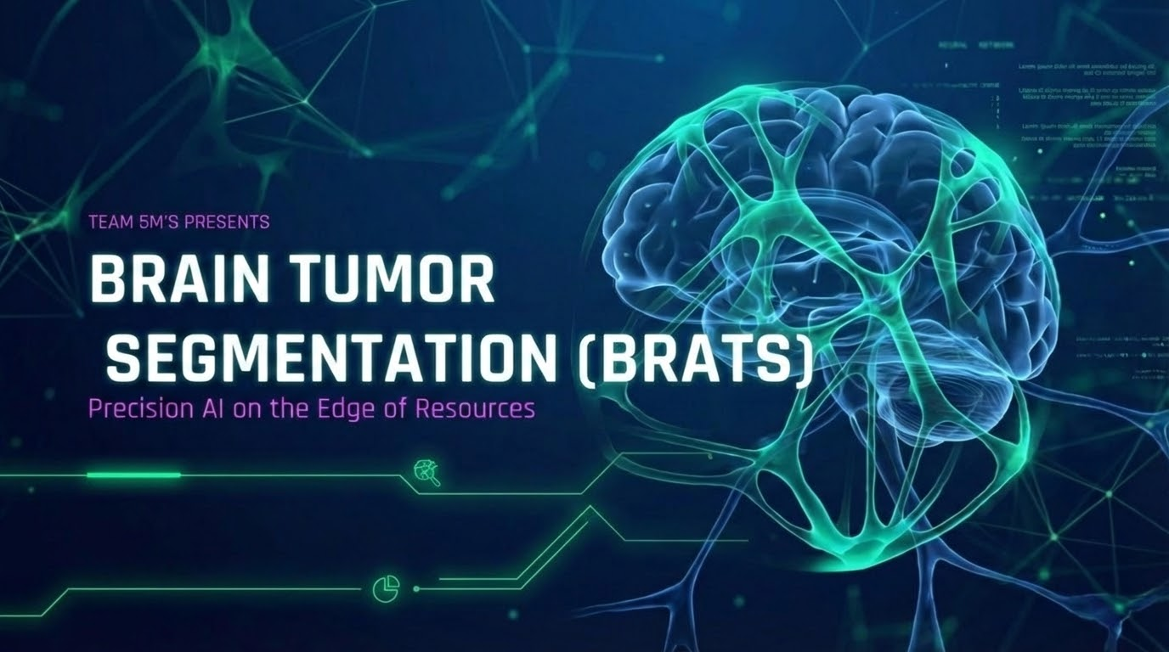



Slide 2


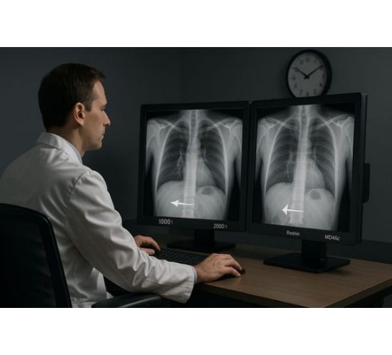
THE MEDICAL REALITY
WHY THIS MATTERS?
Radiologist Burnout: Hours spent manually segmenting tumors slice-by-slice leads to fatigue.
Volume Overload: A single patient scan contains hundreds of 3D MRI slices.
Human Error: Fatigue increases the risk of missing tiny tumor fragments in complex volumetric data.

Slide 3
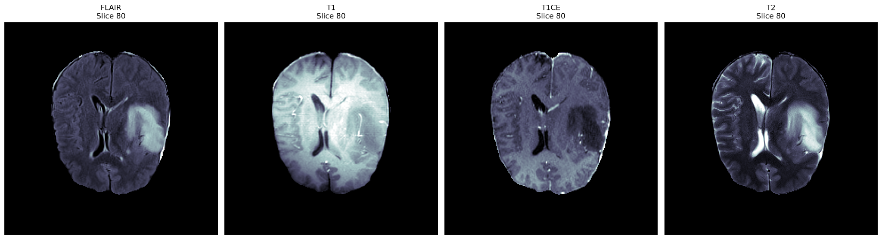
The Four Core MRI Sequence
FLAIR
T1
T1CE
T2

Slide 4


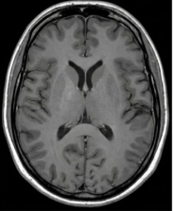
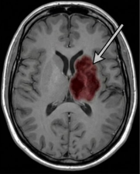
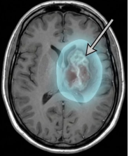
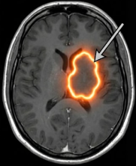


SEGMENTATION CLASSES
Background
Necrotic Tumor Core (NCR)
Represents healthy brain tissue or surrounding air. It is the majority class in most MRI scans.
The dead tissue inside the tumor. Often appears dark in T1-weighted images due to lack of blood flow.
Peritumoral Edema (ED)
GD-enhancing Tumor (ET)
The fluid-filled swelling surrounding the tumor. Indicates the brain's inflammatory response.
The active, growing part of the tumor. Shows high contrast enhancement due to blood-brain barrier breakdown.

Slide 5
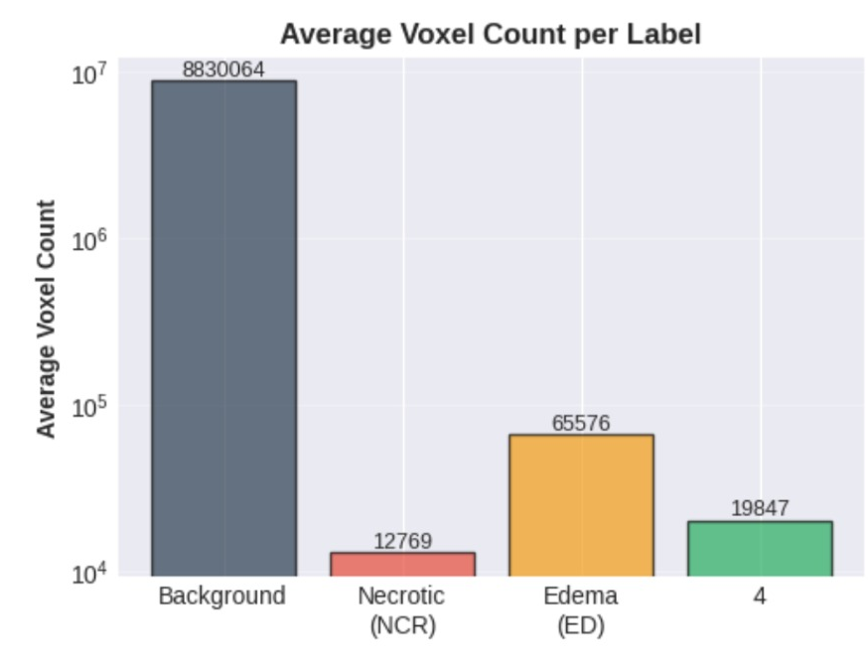
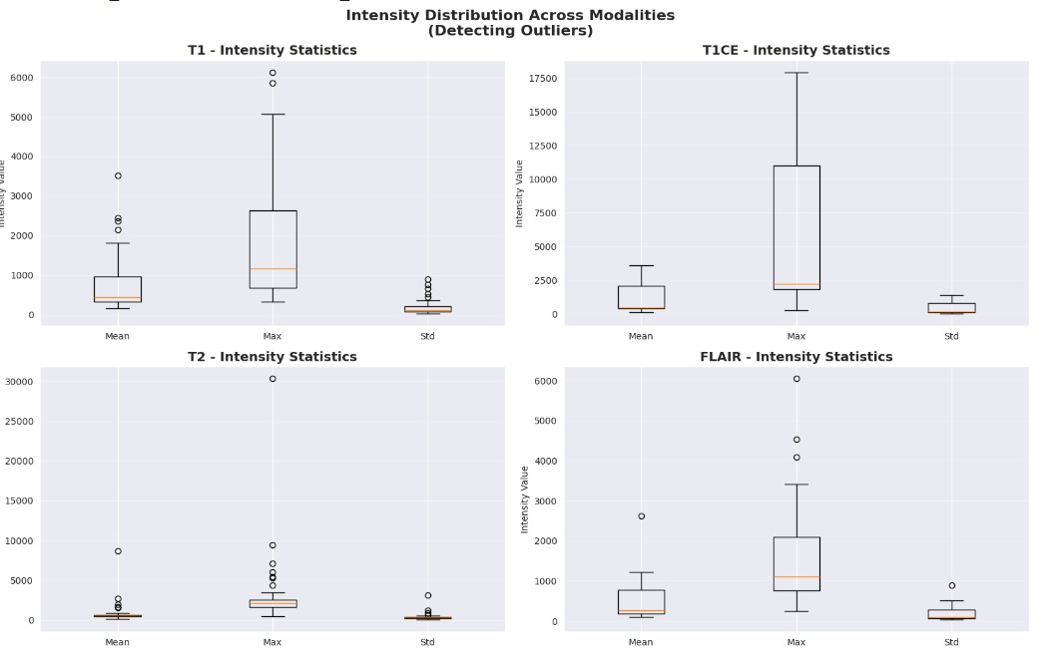
Data Exploration
Inbalance
Outliers

Slide 6






CHALLENGES WE FACED
Unorganized Data
Severe Imbalance
Intensity Variations
MRI data for each patient was stored in inconsistent folder formats with varying naming conventions.
Tumors occupy a very small area compared to the brain volume. Most slices are empty background.
Different scanners produce different intensity ranges, leading to extreme outlier pixel values.
•
Inconsistent folders
•
Background dominance
•
Scanner differences
•
Naming chaos
•
Small tumor ROI
•
Outlier pixels
•
Loading difficulties
•
Empty slices
•
Normalization issues

Slide 7
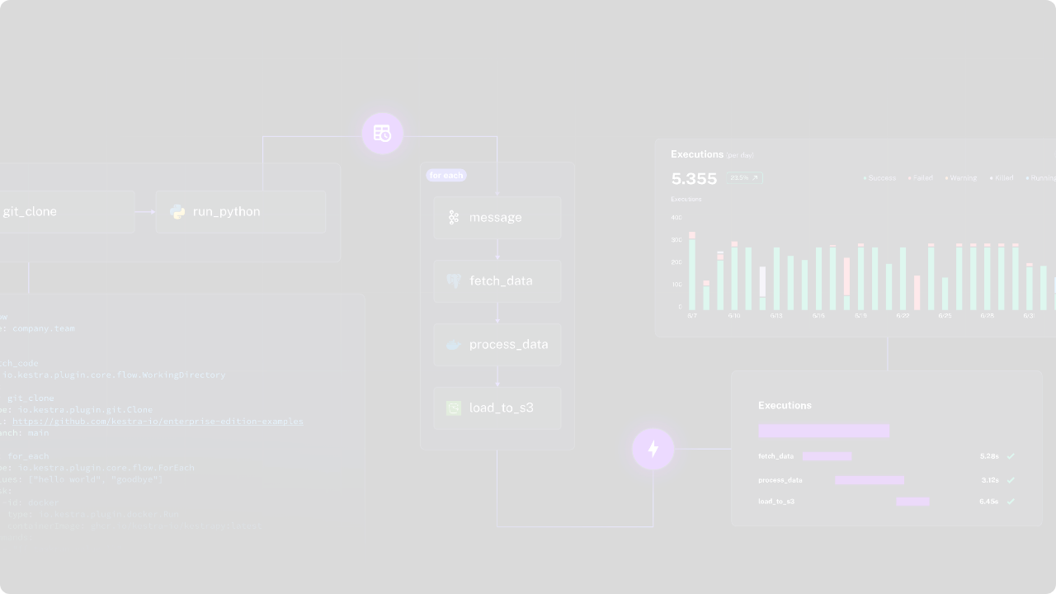








Our Solution And Pipeline
Smart Dataset Loader
Brain-Focused Cropping
Automated script to traverse patient folders, detect modalities, and organize data, reducing manual effort.
Removes unnecessary background to focus training on brain tissue, increasing the tumor-to-background ratio.
Smart Slice Sampling
Robust Normalization
Selects balanced slices (tumor-present vs. tumor-absent) to improve learning stability and performance.
Applied per-modality normalization using 1st and 99th percentiles to standardize intensity ranges [0, 1].

Slide 8
STRATEGY 1: SMART DATA SAMPLING
THE "75-SLICE" PROTOCOL
We focused training exclusively on the central 75 slices where the tumor mass typically resides. This increased information density and dramatically accelerated convergence.
The Fix: 90% of an MRI volume is black background or healthy tissue. Feeding this "empty" data wastes compute.

Slide 9
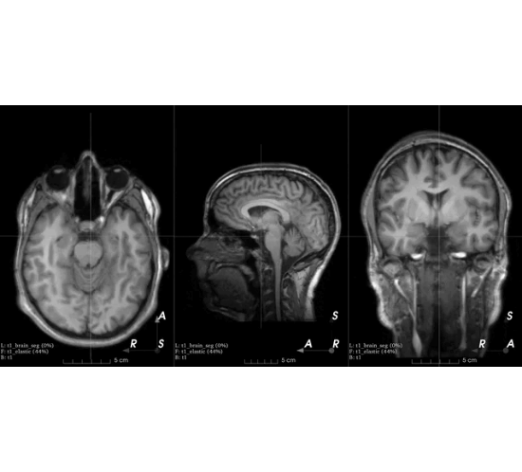
STRATEGY 4: HEAVY AUGMENTATIONS
PREVENTING OVERFITTING
With a limited dataset, neural networks tend to memorize images. We used Albumentations to artificially expand our dataset.
•
Rotation & Flips: Simulating different patient orientations.
•
Elastic Transforms: Simulating natural biological variances in brain shape.

Slide 10

Approach & Decision Journey
MRI Tumor Segmentation: Navigating Constraints and Optimizing Performance
Hackathon 2026 | Technical Report

Slide 11

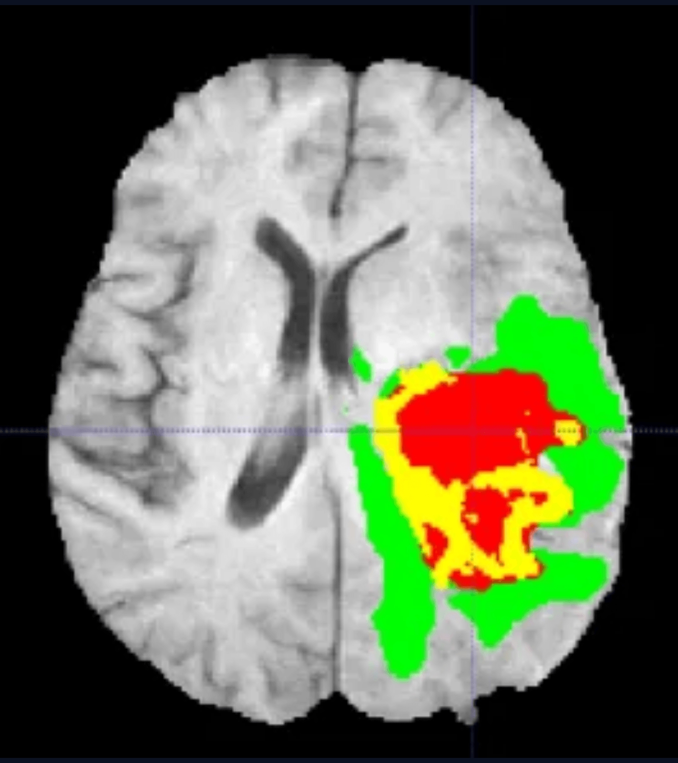
3D Models: Full Volume Context vs. Resource Constraints
Initial Choice
Leveraging 3D Segmentation Models to capture the complete MRI volume and spatial relationships.
Advantages
Superior ability to visualize and process the full tumor volume within the MRI sequence.
The Bottleneck
Prohibitive GPU and memory requirements; training times were too long for a hackathon.

Slide 12

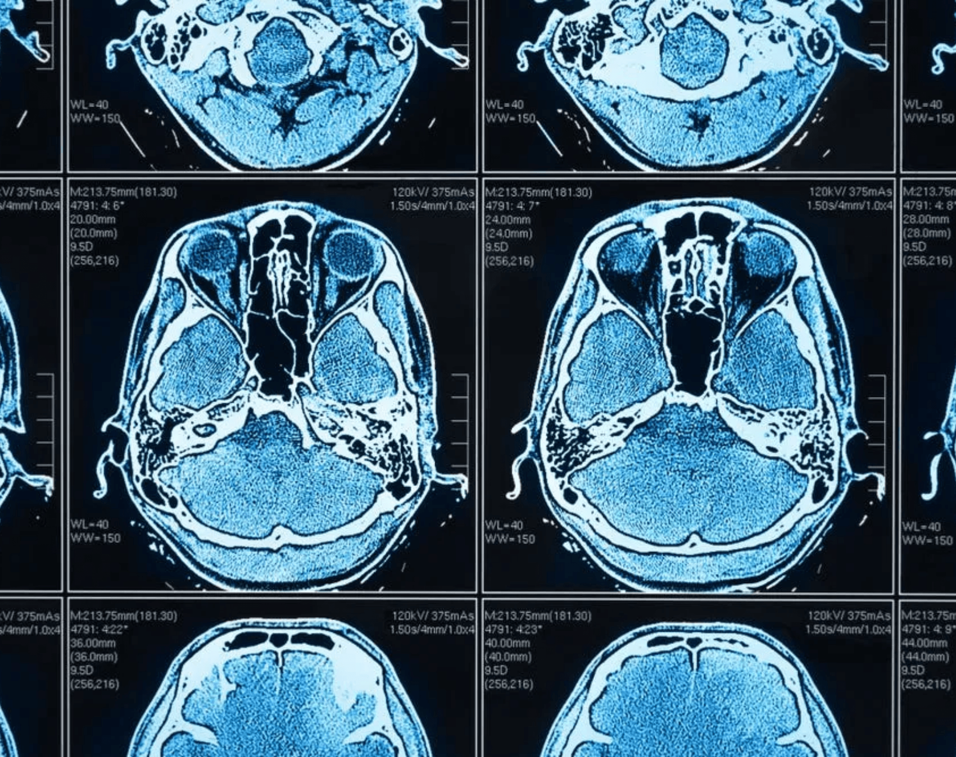
The 2.5D Approach: Partial Context & Training Bottlenecks
Concept
Initial Results
Inputting multiple adjacent slices simultaneously to maintain partial 3D spatial context.
Promising performance metrics, but training speed was extremely slow.
Optimization
Outcome
Attempted using a single random slice per patient to accelerate the training process.
Critical spatial context was lost; the solution lacked the robustness required for competition.

Slide 13
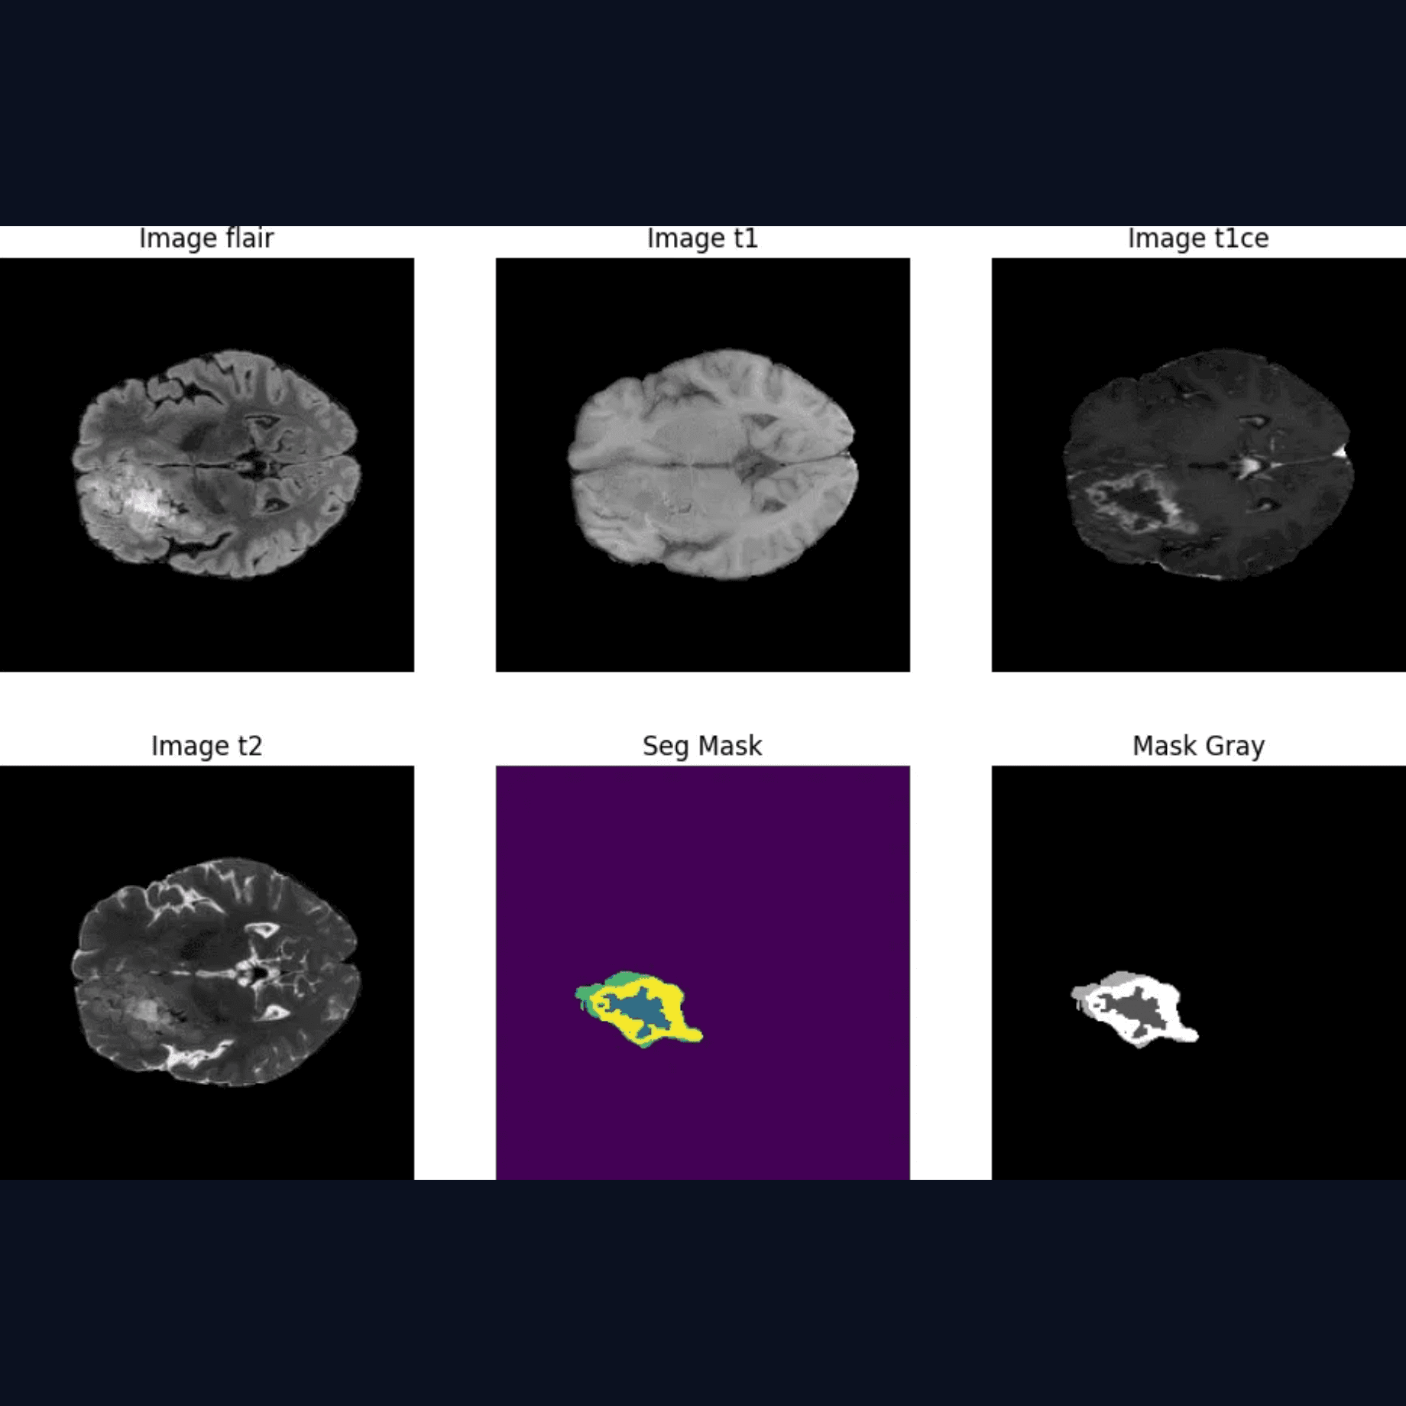
Pivoting to 2D: Speed & Iteration
Decision Point
Faced with the choice between complex pre-trained architectures or building a streamlined model from the ground up.
The Choice
Opted to build a custom 2D segmentation model from scratch to maintain full control over the training pipeline.
Rationale
Simpler models allowed for faster implementation and rapid experimentation cycles, critical in a hackathon environment.

Slide 14

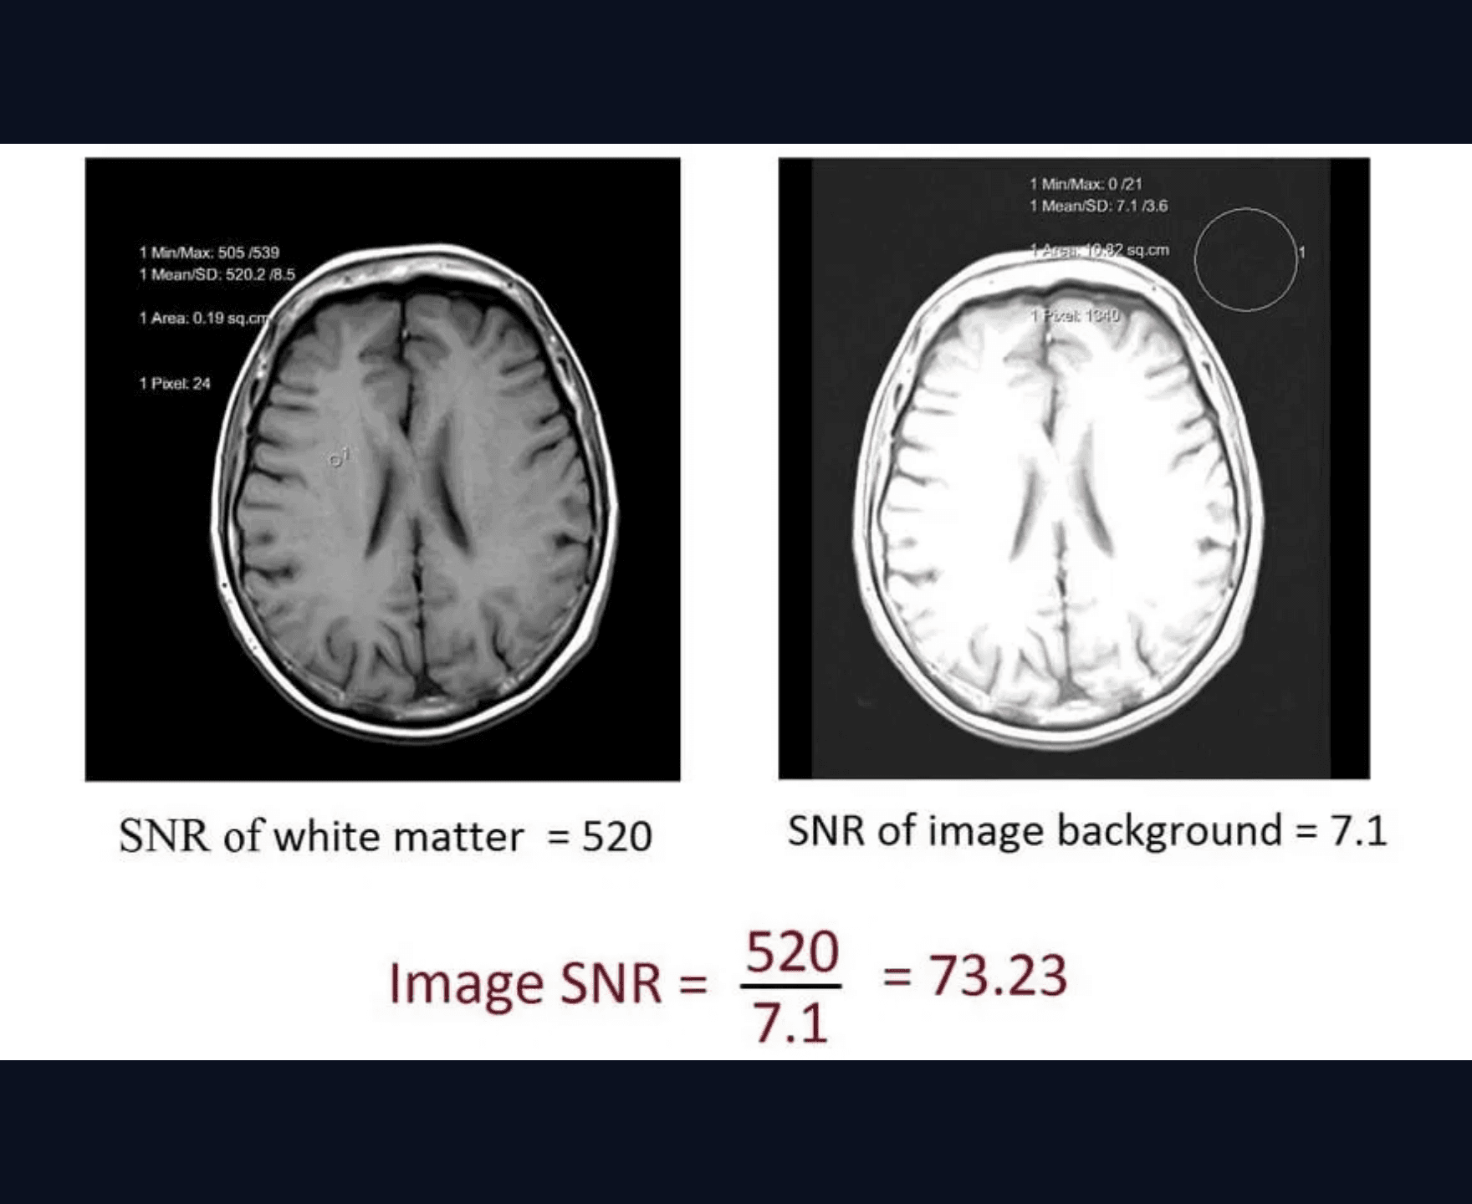
Addressing Noise & Background Interference
The Challenge
Background Noise in Selective Training
Training exclusively on slices containing tumors resulted in high false-positive noise in background regions during inference.
The Strategy
70/30 Sample Distribution
Adjusted the training set to include a 70% tumor and 30% background ratio to teach the model to distinguish non-tumor tissue.
The Outcome
Improved Clarity, Unstable Accuracy
While background noise was significantly reduced, the overall accuracy remained volatile, necessitating further optimization.

Slide 15

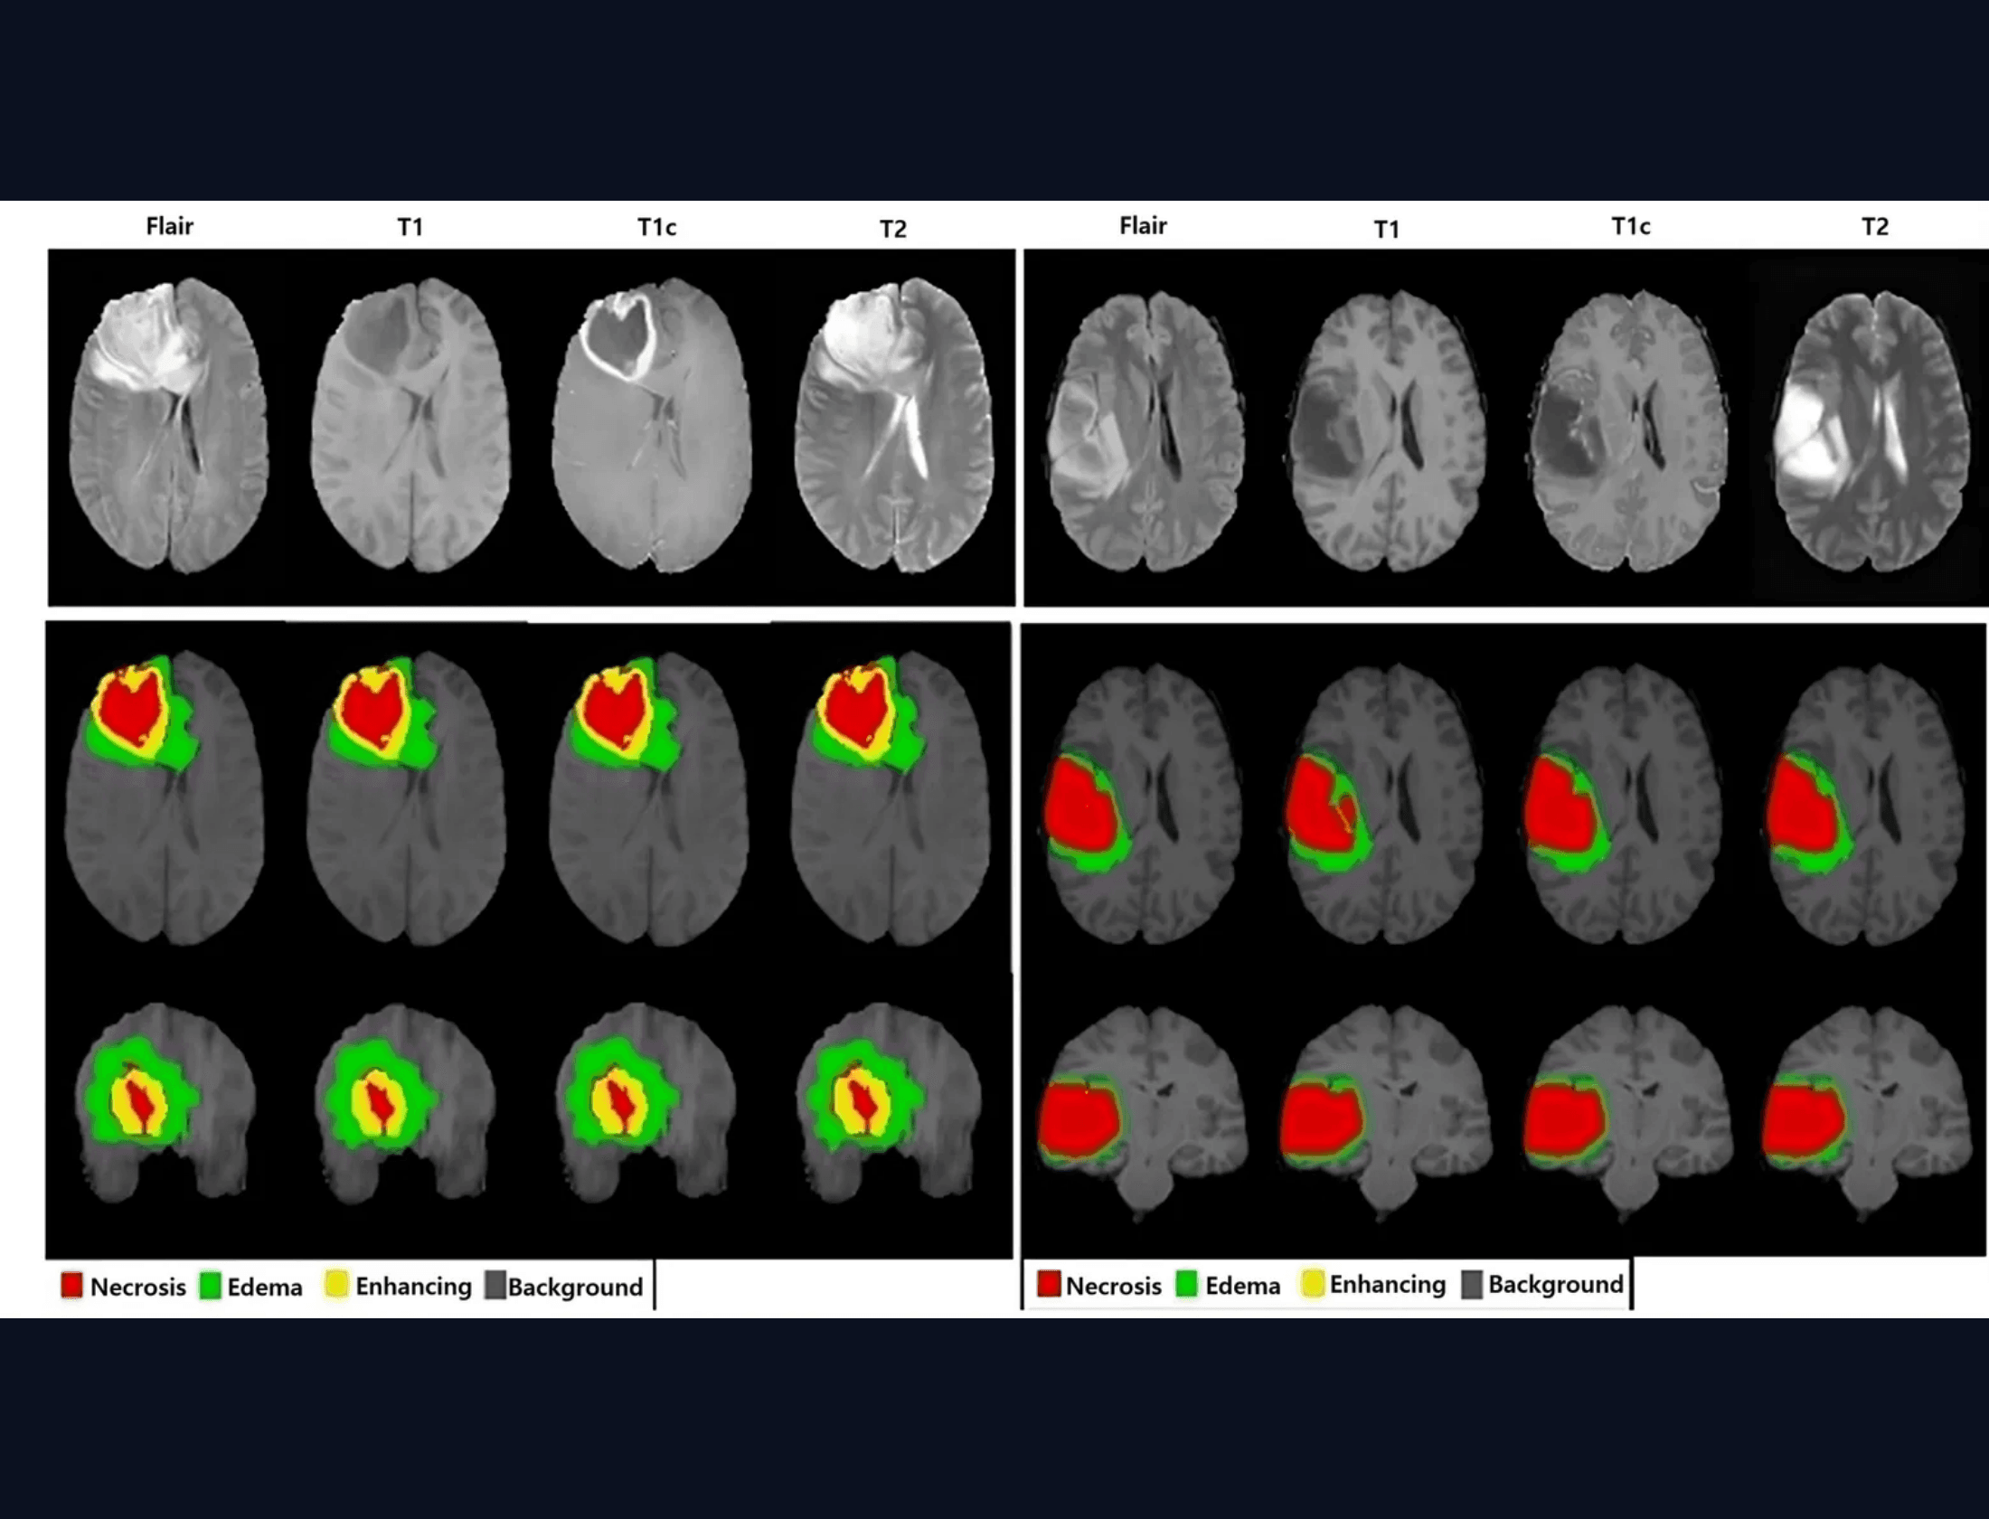
Optimizing Patient Representation
The Problem
Single-slice sampling led to severe under-representation. The model only observed 10–15 slices per patient, which were predominantly background-heavy.
The Solution
Strategic shift to reduce total patient count while significantly increasing the number of slices processed per patient to capture full anatomical context.
50 Slices/Patient: Improved performance
100 Slices/Patient: Optimal stability & accuracy

Slide 16

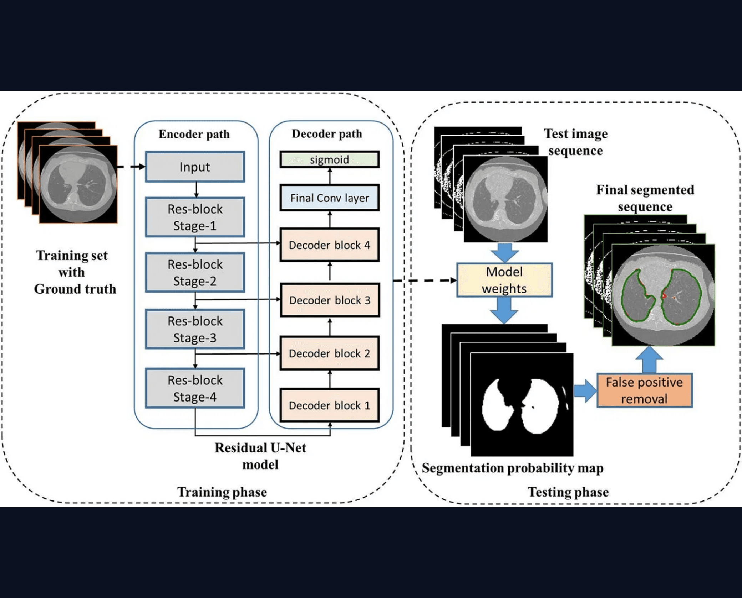
Final Training Configuration
Patient Volume
~500 Patients / Epoch
Slice Density
100 Slices / Patient
Strategic Impact: This configuration maximized anatomical diversity. While training speed was slightly reduced, it delivered a massive leap in model stability and segmentation accuracy.

Slide 17

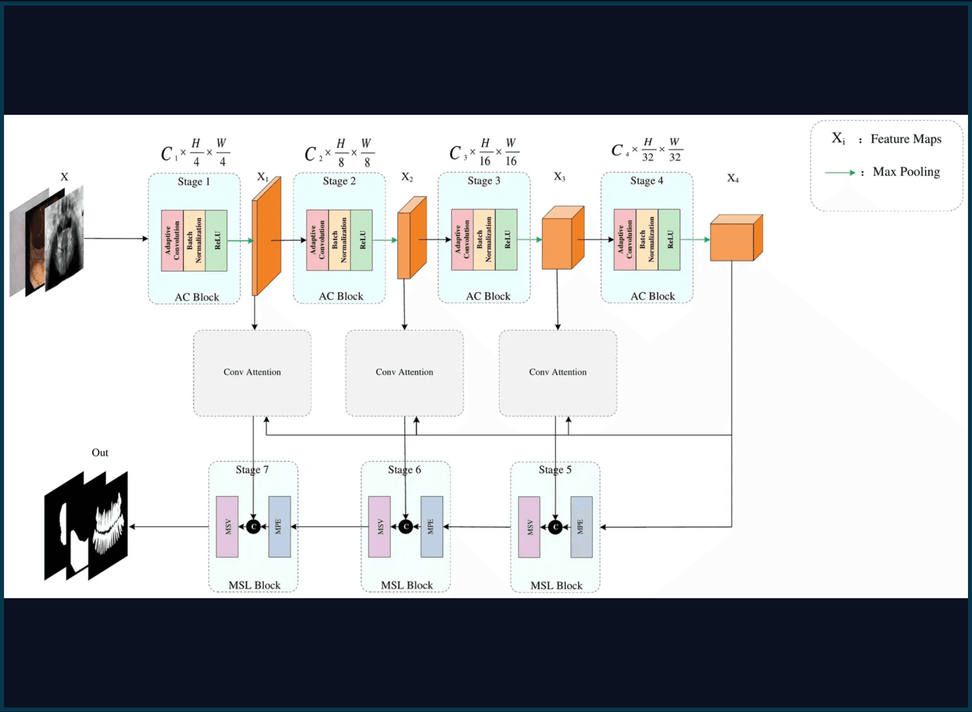
Adopting Pre-trained Architectures: Residual U-Net Integration
Evolution
Architecture
Following the success of our manual baseline, we transitioned to a more sophisticated architecture to capture complex features.
Residual U-Net 32 Filters per layer
Loss Function
Why Residual U-Net?
Combined Objective: Cross-Entropy (CE) + Mean Dice Loss
Selected for its balance of simplicity and high accuracy, specifically optimized for limited computational resources.
Optimization
Key Metric
Designed for rapid convergence within hackathon time limits.
High Leaderboard Accuracy with 32 Filters

Slide 18

Overcoming Time Constraints
Leaderboard Result
~74%
The Bottleneck
Training was computationally intensive; only 15–20 epochs were completed within the critical 8-hour window.
Accuracy achieved despite incomplete training cycles and severe time limitations.
Competition Reality
The training process was cut short by the competition deadline, leaving significant potential for further optimization.

Slide 19

Refining the Balance
Observation
While the 70/30 ratio effectively minimized background noise, it occasionally introduced bias that hindered the precise prediction of tumor boundaries.
Experimentation
Extensive testing of various sampling ratios revealed that each adjustment significantly altered the prediction morphology, indicating that a fixed ratio was not a universal solution.
Final Decision
We concluded that relying solely on sampling ratios is insufficient. Future iterations will focus on a holistic architectural approach to address the tumor-background trade-off.

Slide 20
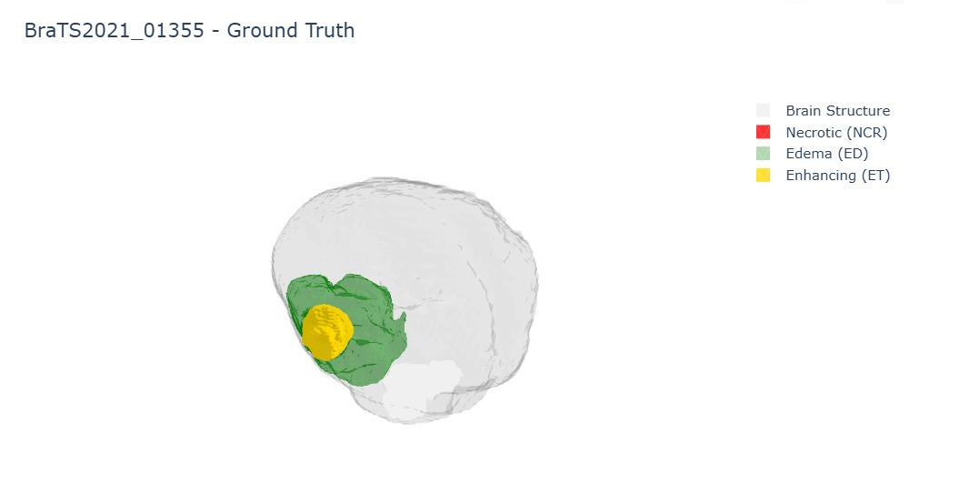
Model Results

Slide 21
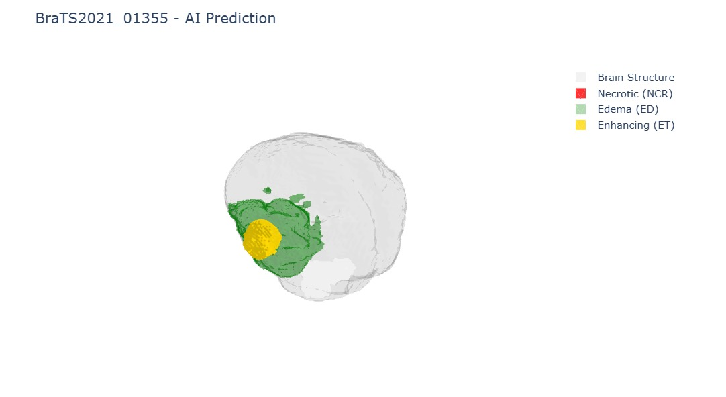
Model Results

Slide 22
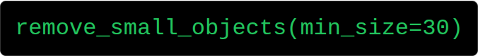
THE "SECRET SAUCE": INFERENCE PIPELINE
THE CLEANING ALGORITHM
How we fixed the low score and removed noise.
"If it's dust, sweep it."

Slide 23






TEST-TIME AUGMENTATION (TTA)
1. PREDICT
2. FLIP & PREDICT
3. AVERAGE
Run inference on the original image.
Flip the image, predict again, and flip back.
Average the predictions. Result: Smoother boundaries and higher confidence.

Slide 24





THE second failure THE NAIVE APPROACH
3D U-NET
MEMORY CRASH
ITERATION BLOCK
Attempted to train a standard 3D U-Net on full MRI volumes.
Immediate CUDA OOM errors. The model was too heavy for the hardware.
Extremely slow training times made rapid experimentation impossible.

Slide 25


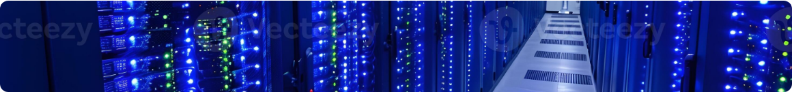
THE "KAGGLE" BOTTLENECK
LIMITED RESOURCES
THE 3D CHALLENGE
We didn't have unlimited cloud compute or H100 clusters. We were constrained to standard Kaggle GPUs (P100/T4) with limited VRAM (16GB).
Processing full 3D volumetric MRI data requires massive memory. Feeding entire volumes resulted in immediate Out of Memory (OOM) errors.

Slide 26

DEPLOYMENT: BEYOND THE NOTEBOOK
PRODUCTION-READY AI
Backend: FastAPI for high-performance inference.
Docker: FastAPI for high-performance inference.
Frontend: React dashboard for doctors.
Visualization: Integrated 3D interactive viewer for exploring segmented tumor volumes.

Slide 27
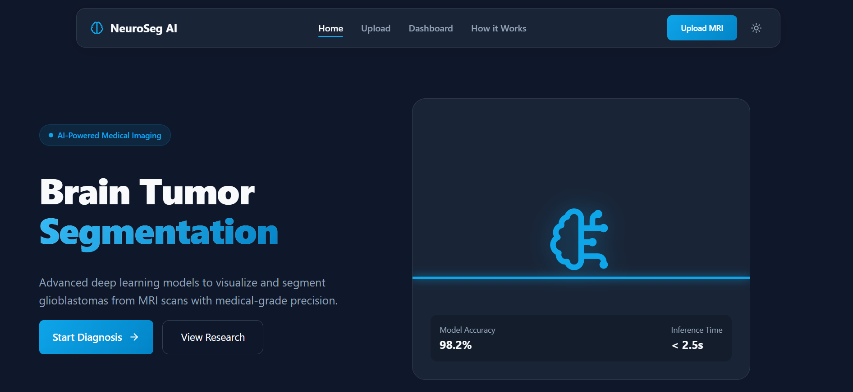
DEPLOYMENT: BEYOND THE NOTEBOOK

Slide 28


CONCLUSION
We didn't just build a model; we engineered a resilient system optimized for constraints.
Next Steps: Deploying on edge devices in rural hospitals to democratize access to precision diagnostics.
Q&A

Slide 29

Let’s Try Our Website
https://neuroseg_ai.datacraft.in.net/

